Slide 1
TRAFFIC SIGN DETECTION
Hüseyin Yiğit Ülker

Slide 2
High-level Overview of the Paper
The limitations of conventional traffic sign detection systems.
Slow and poor performance of traffic sign detection for places where real-time traffic sign detection is required
Deep Learning Approach for Traffic Sign Detection
Utilizing the YOLOv8 model for efficient and accurate real-time detection of traffic signs.
Datasets
Analysis of results
‹#›

Slide 3
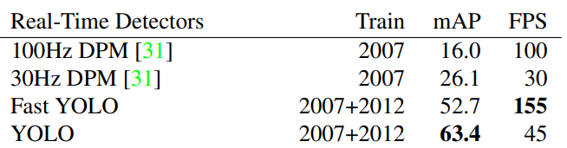

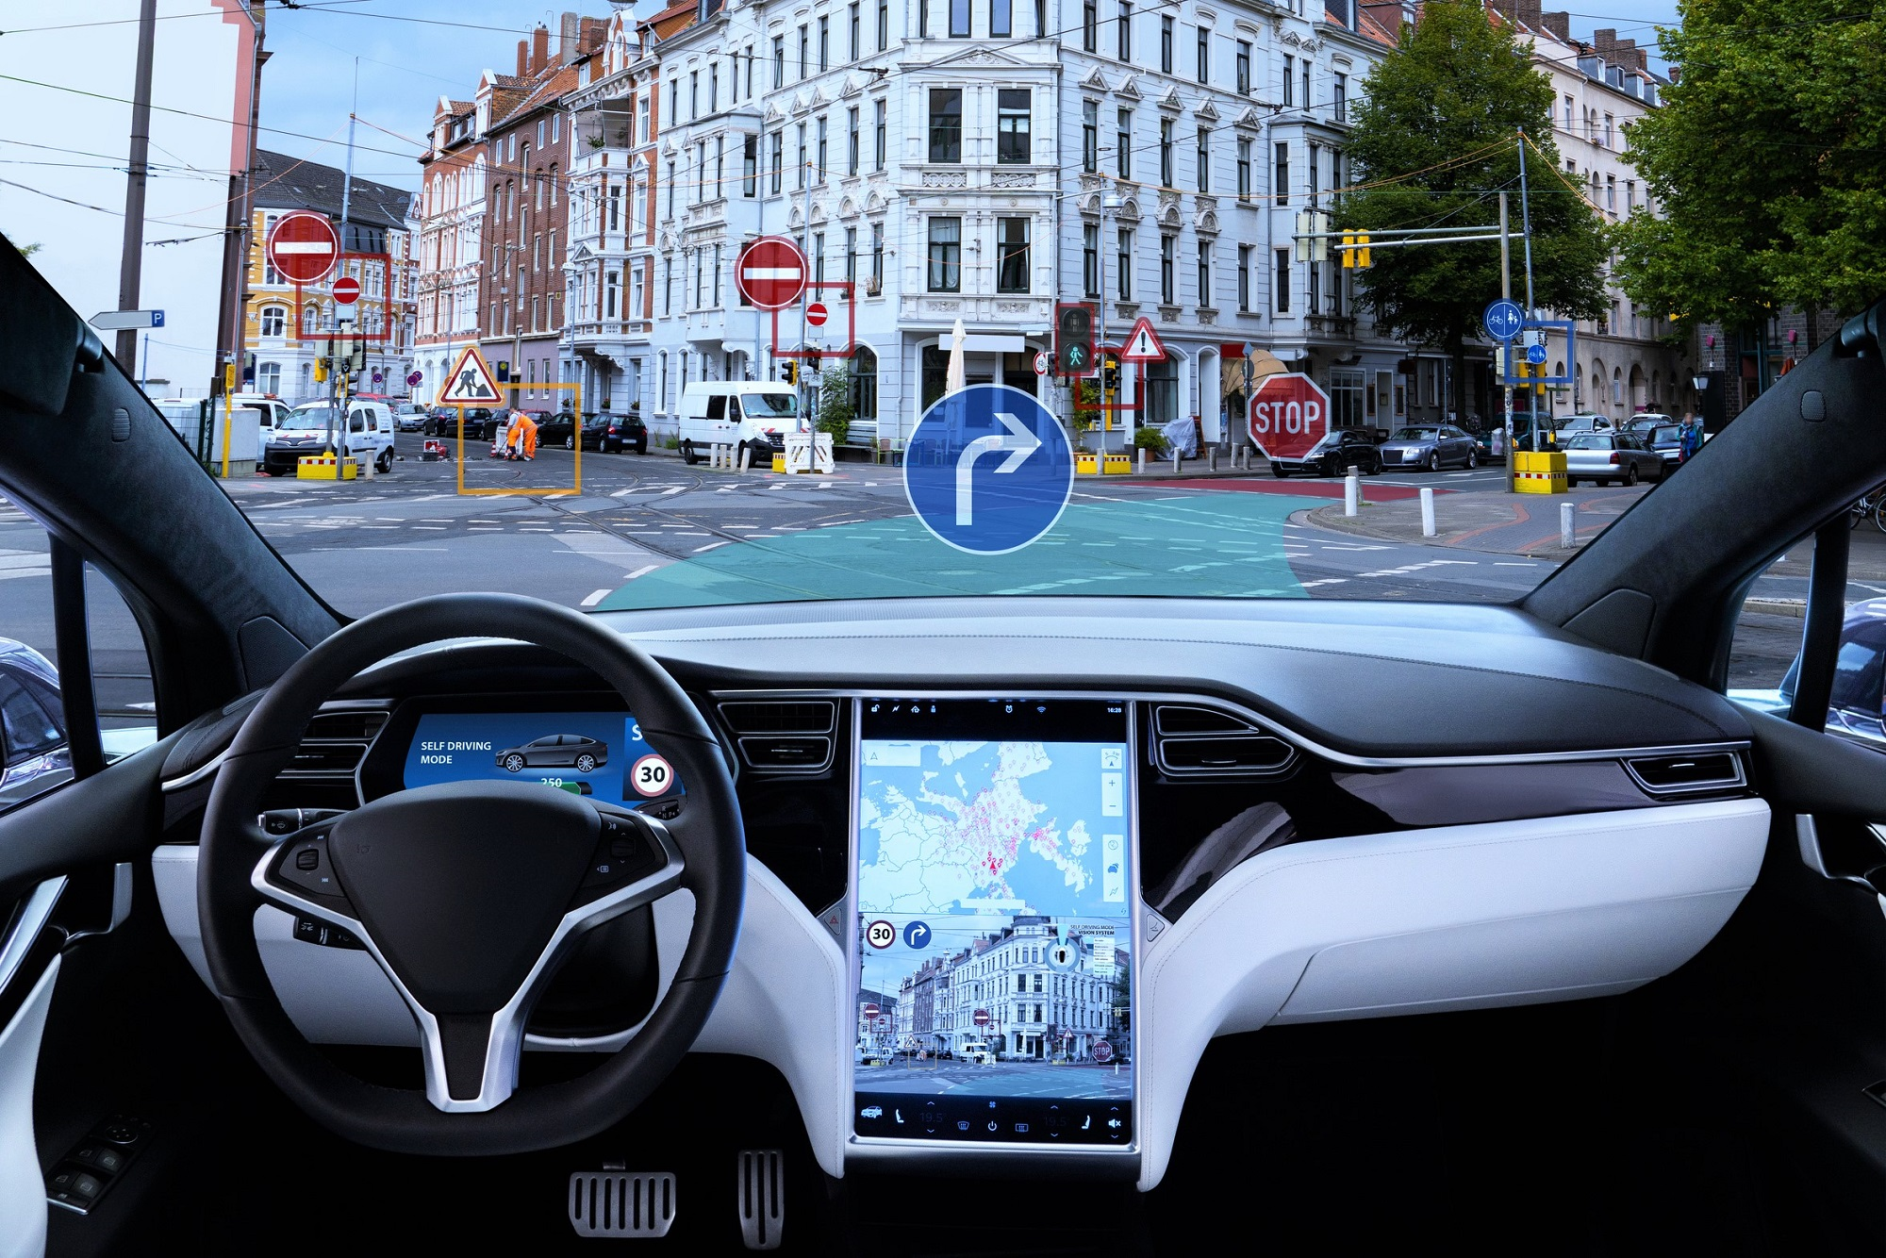
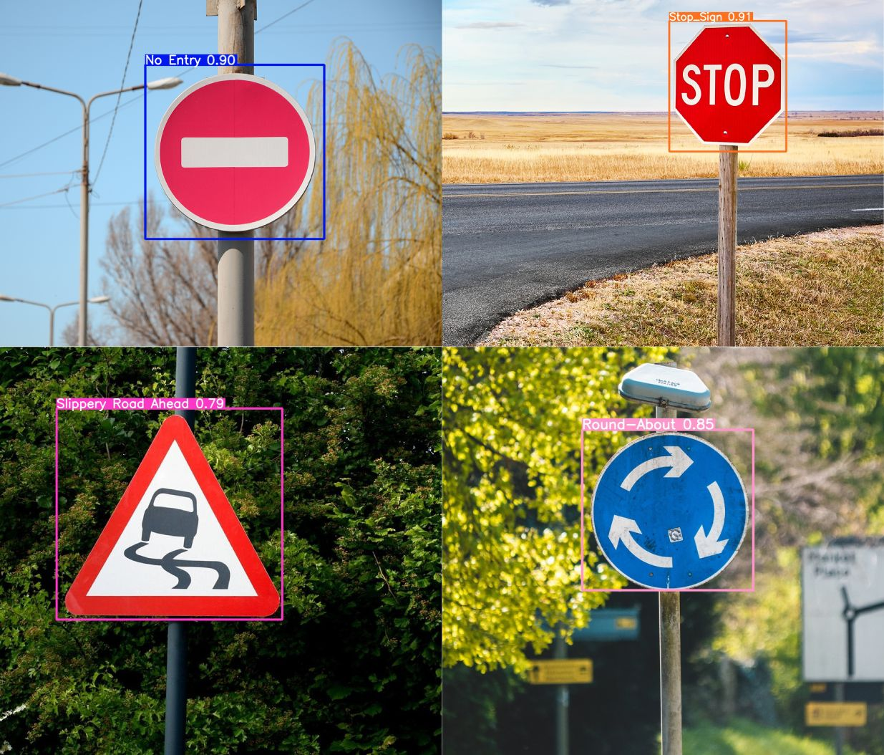
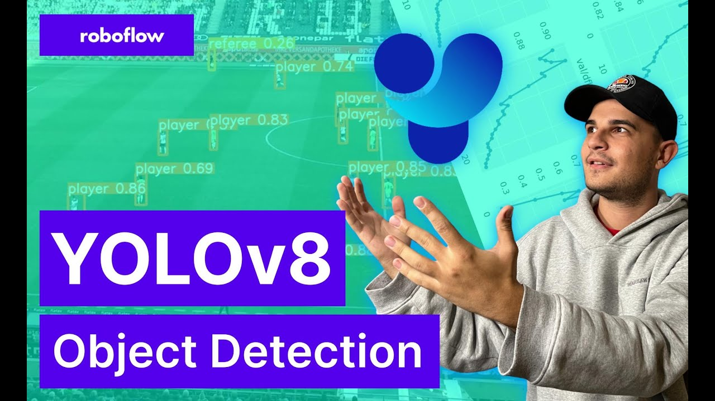
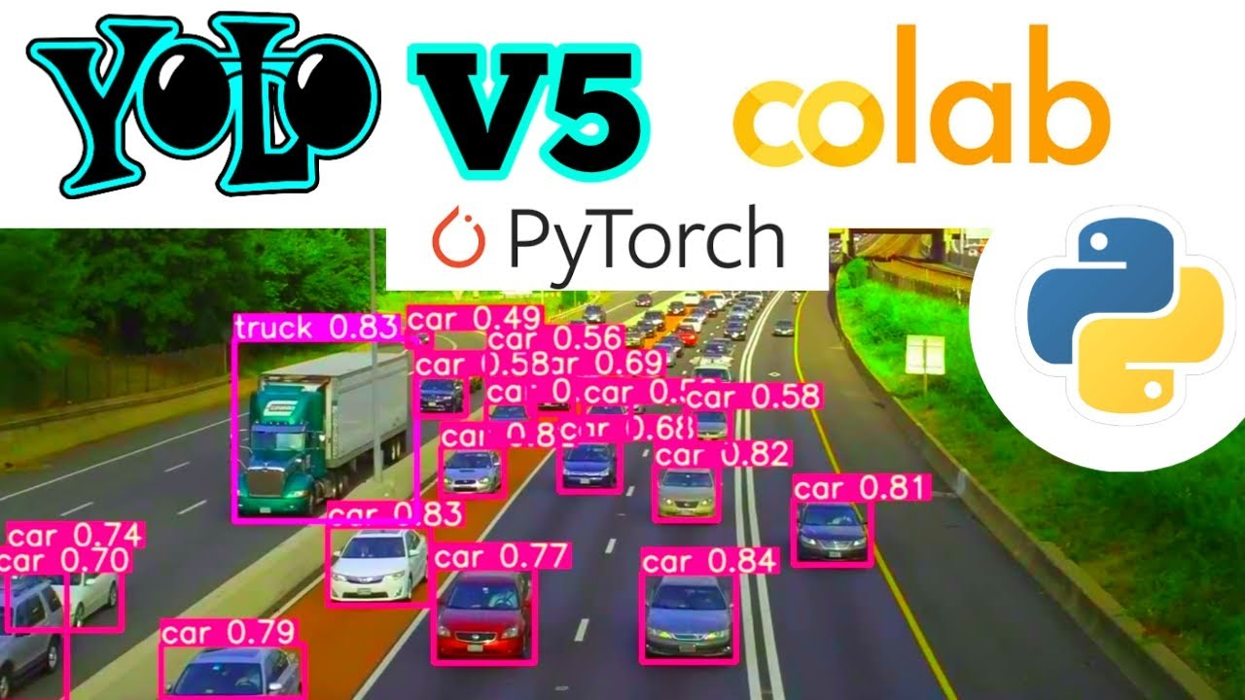
Problem Statement and Motivation
In pre-YOLO methods, the performance of traffic sign detection is characterized by slow response times and inadequate accuracy, particularly in environments where real-time traffic sign detection is crucial.

Slide 4
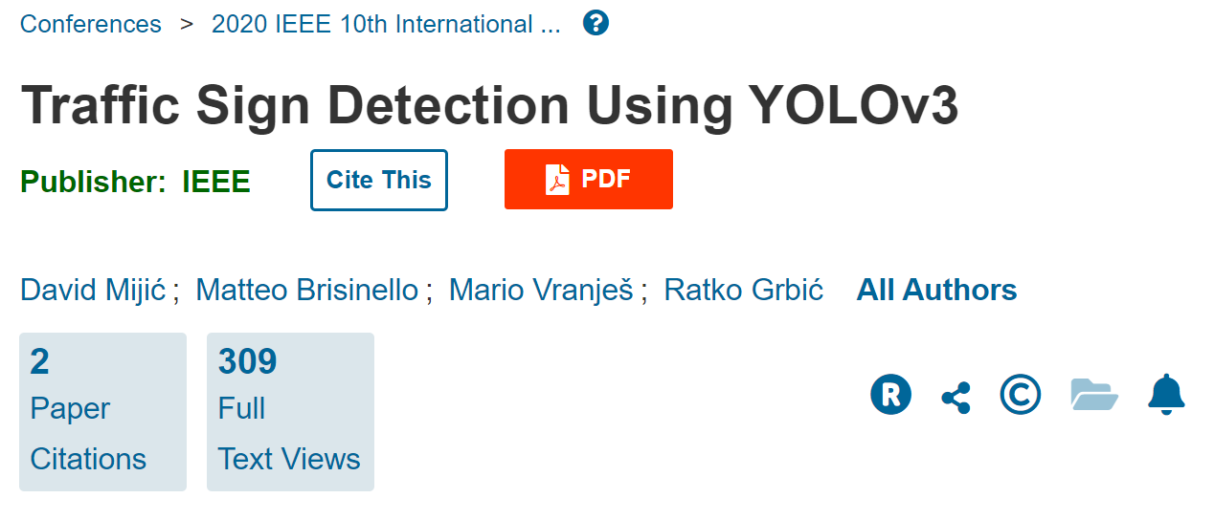
Related Work
Models : YOLOv3
Performance Measure : precision, recall, F-1 score, intersection over union (IoU), average precision (AP) and mean average precision (mAP)
Dataset : They generated their own dataset
Paper link : https://ieeexplore.ieee.org/stamp/stamp.jsp?tp=&arnumber=9352180
‹#›

Slide 5

Related Work
Models : YOLOv5
Performance Measure : Precision, Recall, mean average precision (mAP)
Dataset : Tsinghua-Tencent-100K (TT100K)
Paper link : https://www.matec-conferences.org/articles/matecconf/pdf/2022/02/matecconf_icpcm2022_03023.pdf
‹#›

Slide 6
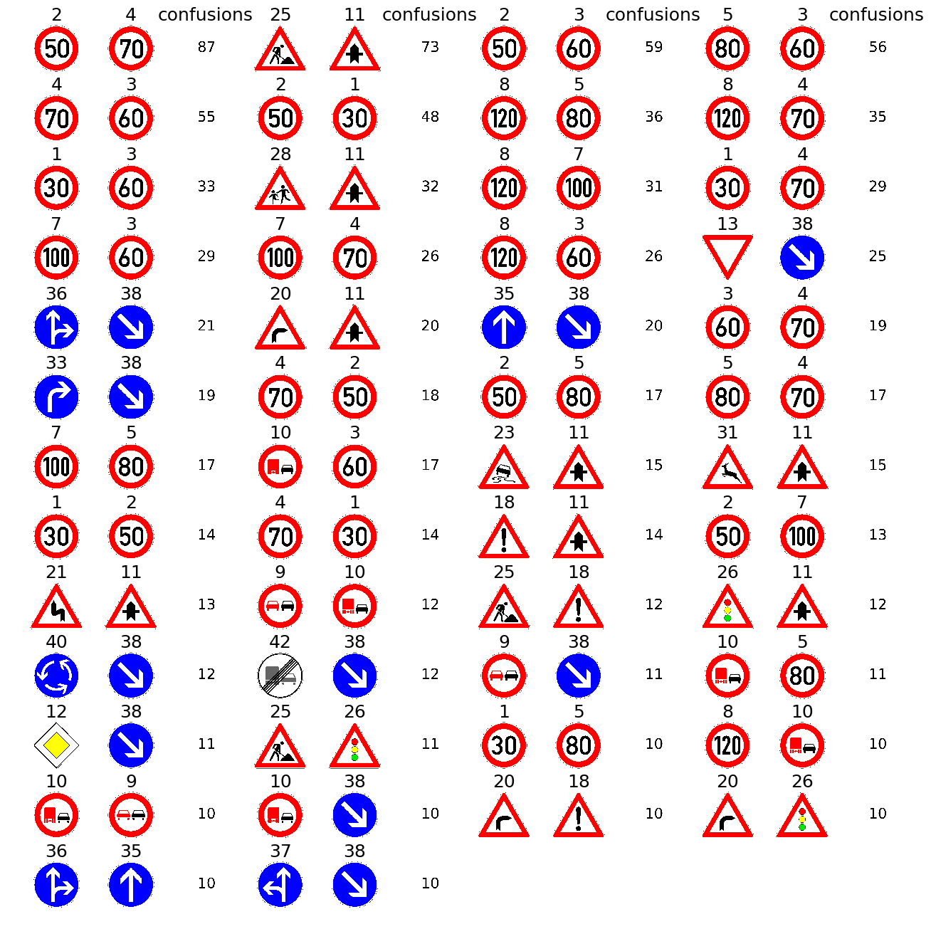
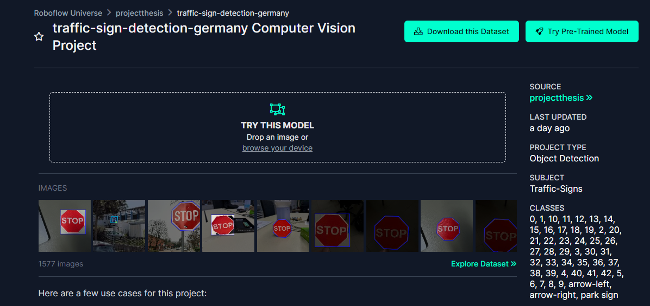
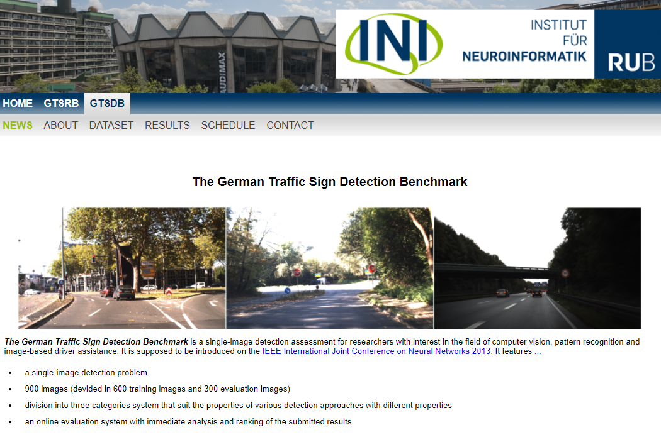
Datasets
1- Original German Traffic Sign Detection Benchmark (GTSDB) (43 classes)
2- traffic-sign-detection-germany Image Dataset (46 classes)

Slide 7
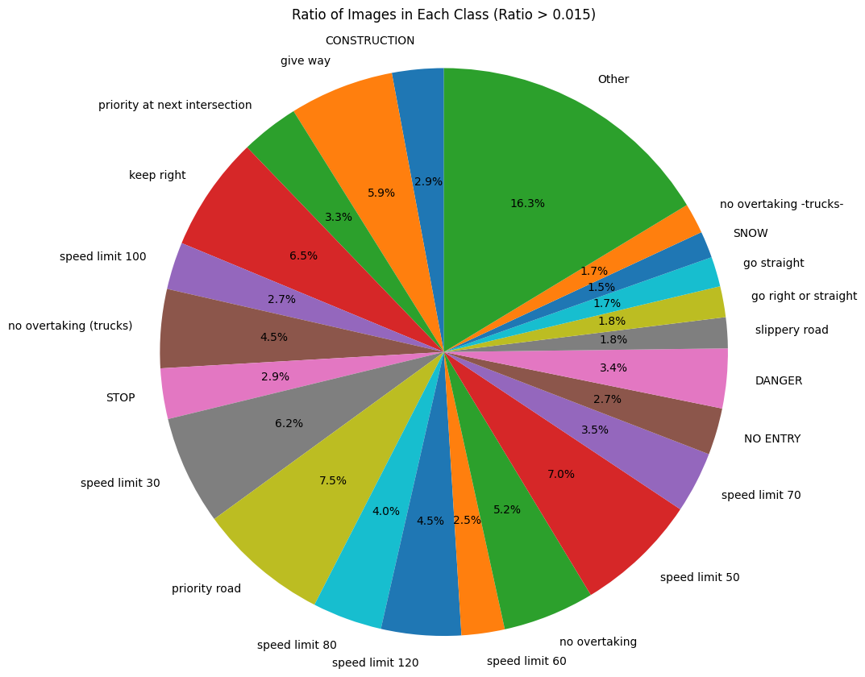
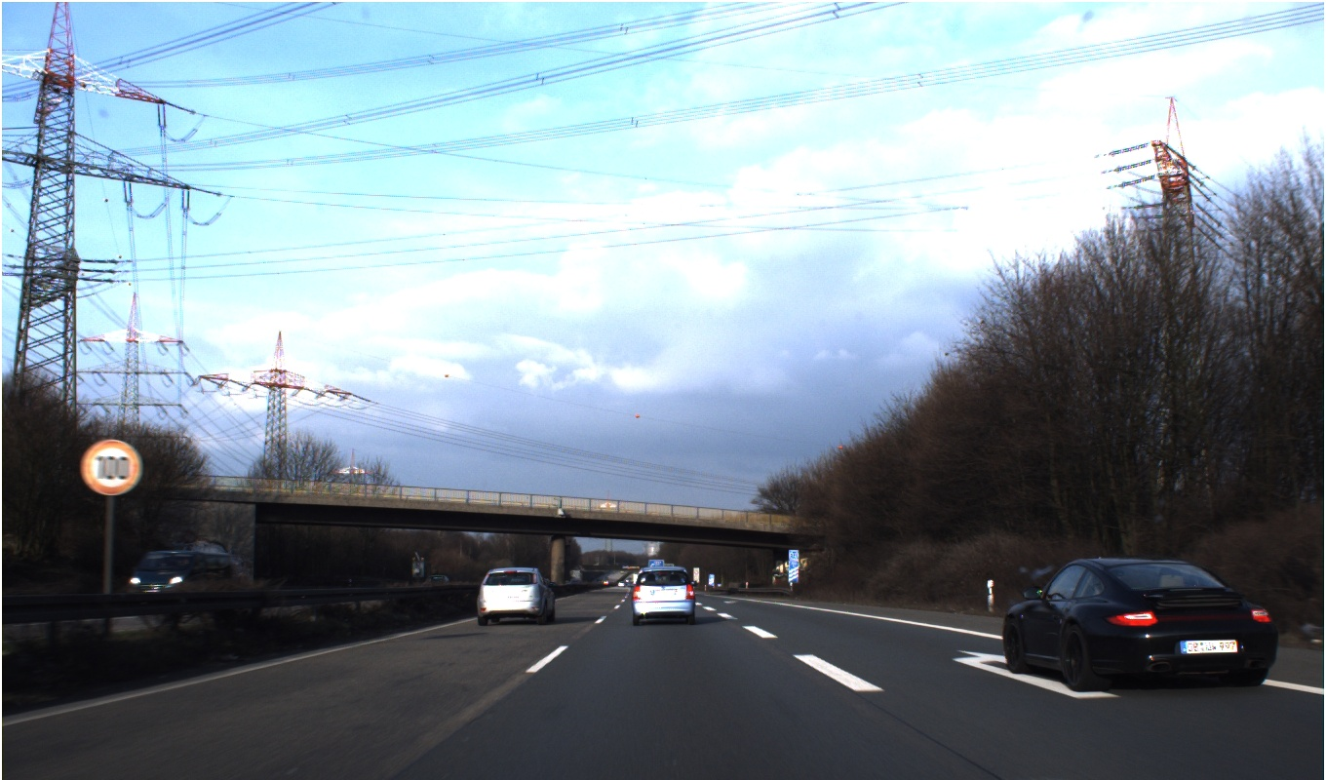
German Traffic Sign Detection Benchmark (GTSDB)
contains 900 images (devided in 600 training images and 300 evaluation images)
contains 43 classes
original format images are in .ppm format
dataset link:
https://benchmark.ini.rub.de/gtsdb_news.html
sample image from dataset
class distribution of the GTSDB

Slide 8
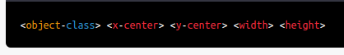
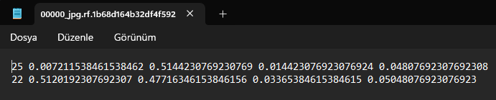
traffic-sign-detection-germany Image Dataset
contains 1311 images
train:1149 - validation:108 - test :54
contains 46 classes
The dataset was in YOLO format.
YOLO text file format
class distribution of the dataset

Slide 9

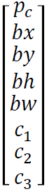
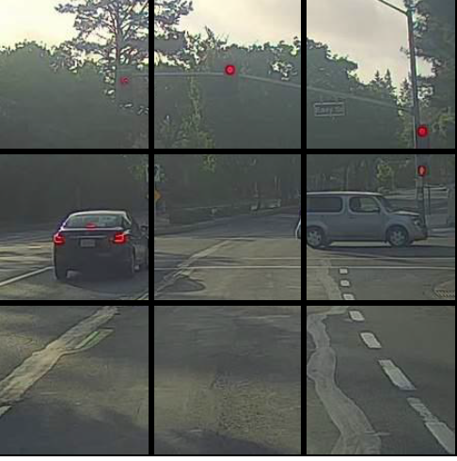
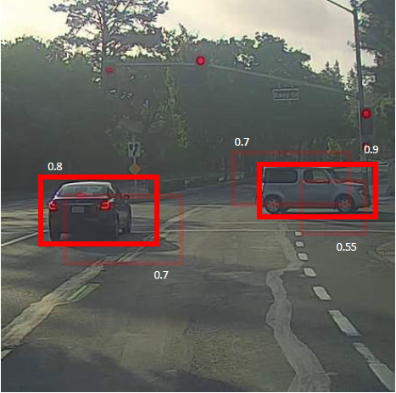
YOLO
Network Architecture: YOLO typically uses a convolutional neural network (CNN)
Grid Division: YOLO divides the input image into an S x S grid.
Anchor Boxes: YOLO employs anchor boxes, which are predefined boxes of different sizes and aspect ratios.
Prediction Generation: Within each grid cell, YOLO predicts multiple bounding boxes
Non-maximum Suppression: After generating bounding box predictions, YOLO applies non-maximum suppression (NMS) to eliminate redundant or overlapping bounding boxes.

Slide 10
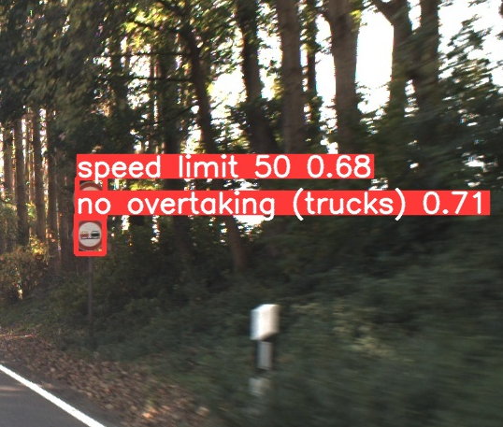
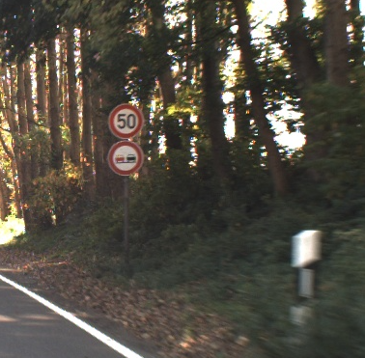
YOLO
Class Prediction: YOLO also predicts the class probabilities for each bounding box, indicating the likelihood of different object classes present in the image.
Training: During training, YOLO utilizes a loss function that incorporates both localization loss (measuring the accuracy of bounding box predictions) and classification loss (measuring the accuracy of class predictions).
Inference: During inference, YOLO applies the trained network to input images and performs the prediction process efficiently in a single forward pass.

Slide 11
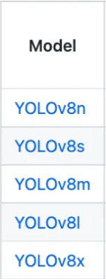
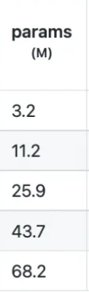
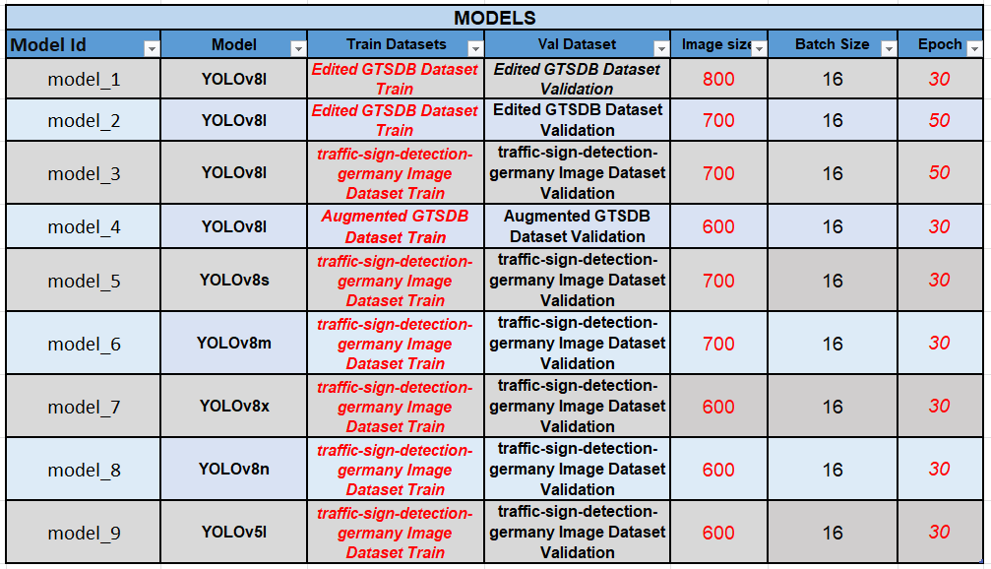
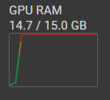
Model Train Details

Slide 12
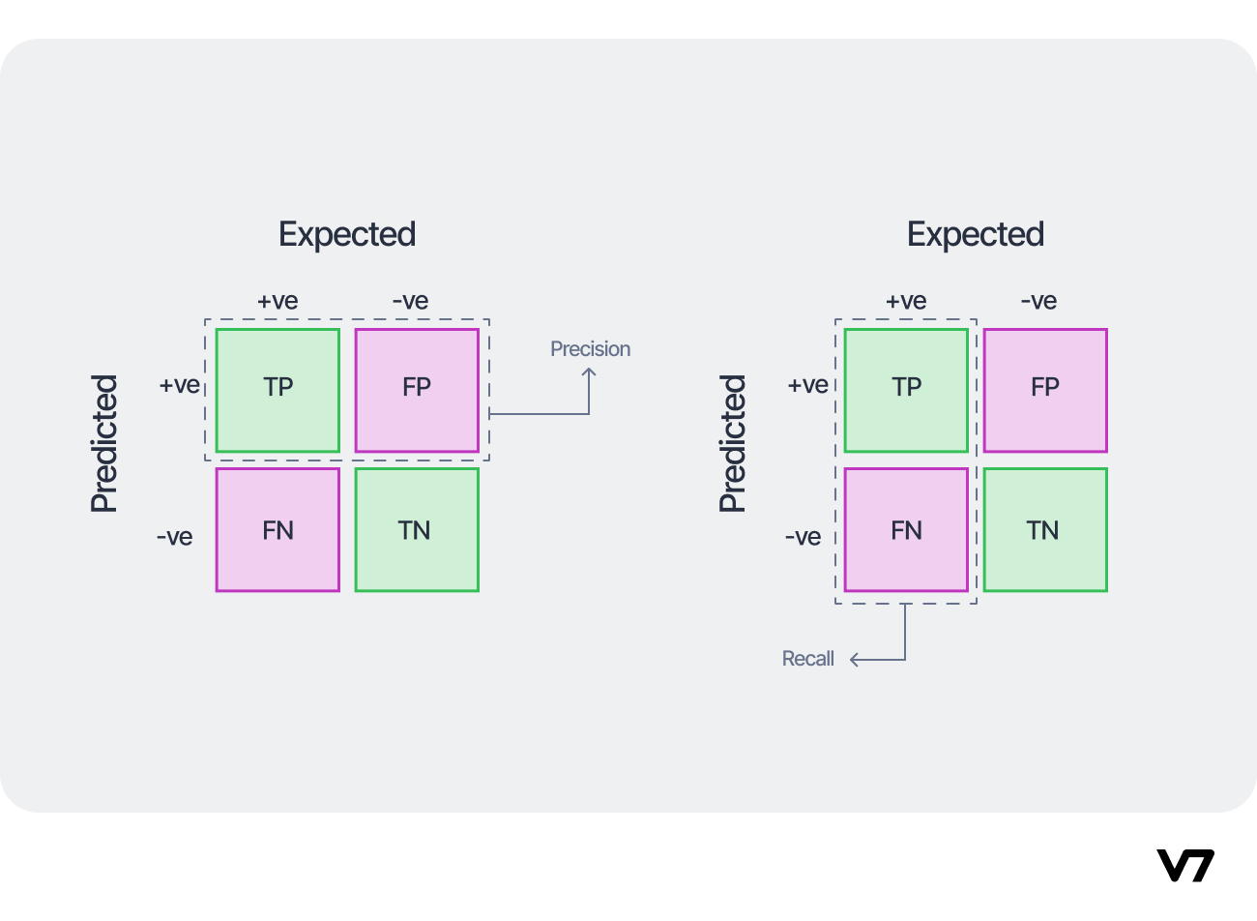
Metrics for Measuring the Success of the Models
- Precision
- Recall
- Average Precision (AP)
The average precision (AP) is a way to summarize the
precision-recall curve into a single value representing the average of all precisions.

Slide 13
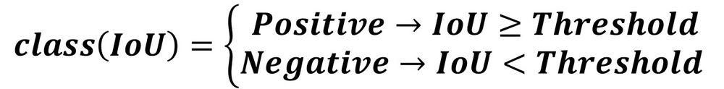
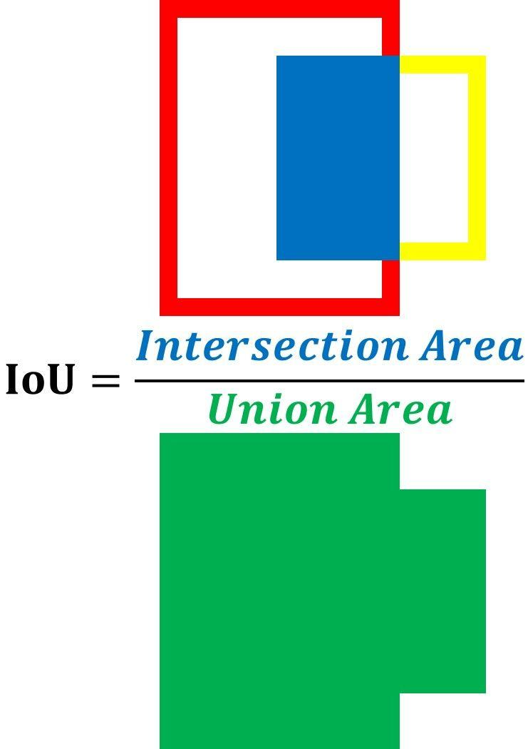
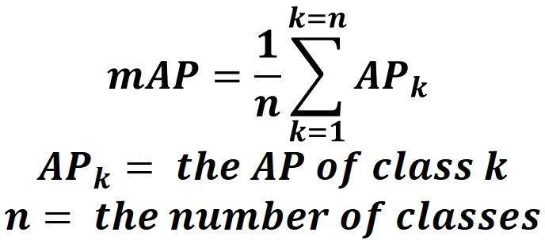
Metrics for Measuring the Success of the Models
- Intersection over Union (IoU)
- Mean Average Precision (mAP)
To calculate the mAP, start by calculating the AP for each class.
The mean of the APs for all classes is the mAP.

Slide 14
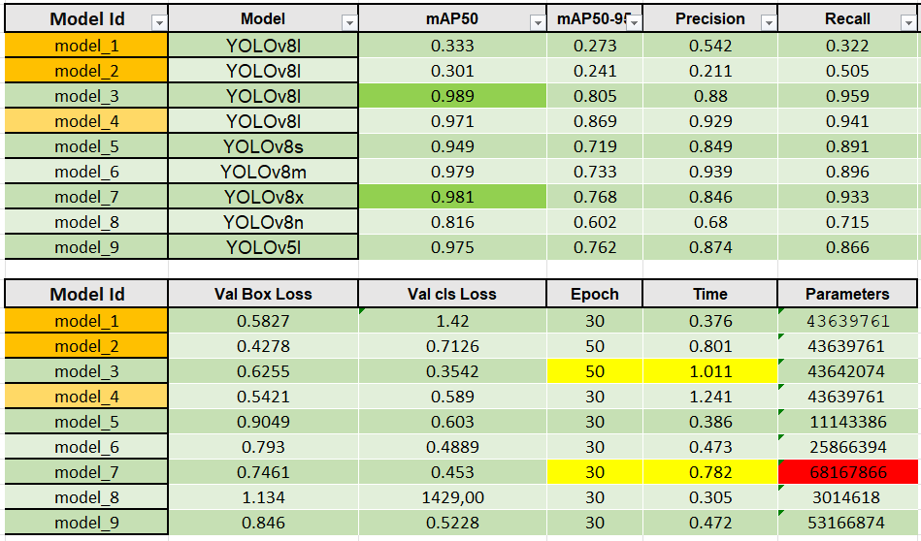
Results of all experiments

Slide 15
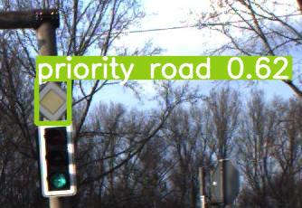
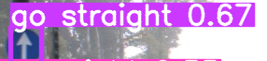
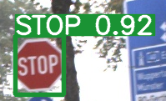
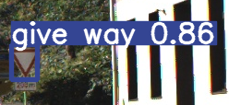
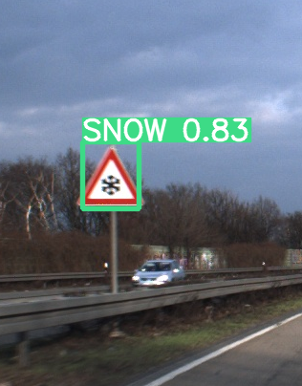
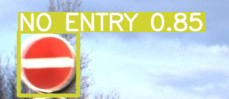
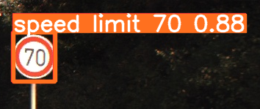
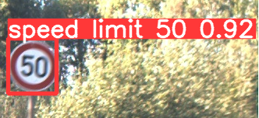
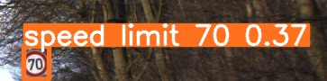
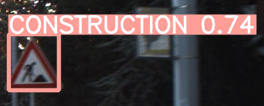
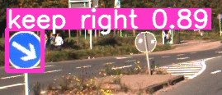
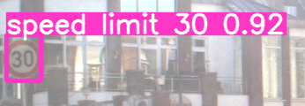

Slide 16
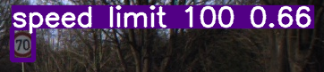
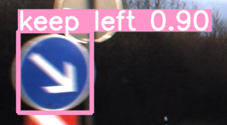
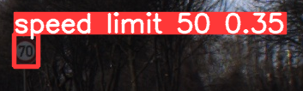
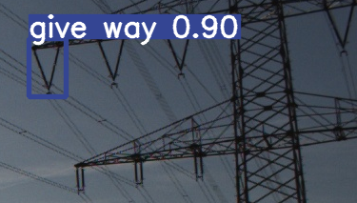
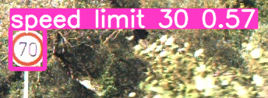

Slide 17
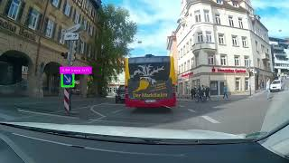

Slide 18
THANK YOU FOR LISTENING
Here is the github link of all my work:
https://github.com/huseyin-yigit-ulker/Traffic-Sign-Detector

